Slide 1







Various Technologies trend analysis and their representation.
Akshay Kumar G
20th Dec 2022

Slide 2



OUTLINE
Executive Summary
Introduction
Methodology
Results
Visualization – Charts
Dashboard
Discussion
Findings & Implications
Conclusion
Appendix

Slide 3

EXECUTIVE SUMMARY
Analyzed various technologies that are currently being used or worked with.
Top 10 programming languages that are currently used or worked with.
Top 10 databases that are currently used or worked with.
Top platforms that are used or worked with.
Top 10 Web Frames that are used or worked with.
Analyzed and visualized various technologies that are most desired for the next year.
Top 10 programming languages that are most desired for the next year.
Top 10 databases that are currently used or worked with.
Top platforms that are most desired for the next year.
Top 10 Web Frames that are mostly desired for the next year.
Demographic analysis of the data.

Slide 4

INTRODUCTION
Objective:
To get to know what are the technologies that are going to in demand in the future.
Advantages:
To upskill based on the future popular technologies.
How the demographics is going to be various technologies like programming languages, databases, web frames etc.,
Useful for HR and IT firms.

Slide 5

METHODOLOGY
Data Collection
Python get and requests library in jupyter notebook.
Data Exploration
SQL Queries and Python jupyter notebook.
Data Cleaning
Cleaning done using python pandas library in jupyter notebook.
Data Visualization
Basic visualization done using python jupyter notebook.
Python matplotlib library.
Python seaborn library.
Dashboarding
Software used: IBM Cognos
Data Presentation
Microsoft Power point used for presenting the work.

Slide 6
RESULTS
From the Current technologies analysis:
It seems that the top 3 programming languages that the respondents are worked or used are JavaScript, HTML/CSS and SQL respectively.
From Top 10 databases perspective we can tell that MySQL is leading the race with close 2nd and 3rd going to Microsoft SQL server and Postgre SQL respectively.
Top Platforms that are being used are Linux and then comes the Windows.
Top Web Frames used are Jquery.js, Angular.Js and React.Js
From the Future technologies trend analysis:
It seems that the top 3 programming languages that the respondents are looking for the future to learn or use are JavaScript, HTML/CSS and Python respectively.
From Top 10 databases perspective we can tell that Postgre SQL is leading the race with close 2nd and 3rd going to Mango DB and MySQL and Redis respectively.
Top Platforms that are being used are Linux and then comes the Docker and AWS.
Top Web Frames used are React.Js, Angular.Js and Vue.Js.

Slide 7
RESULTS(contd..)
From the Demographics point of view:
When the survey was classified based on the gender we came to know that almost 94% of the respondents were Men.
From the countries perspective we can say that most of the respondents belong and United States.
When the age of the respondents who participated in the survey is observed, maximum of the respondents belong to the age group of 25 to 30 y/o.
When we check the education level of the 94% of men who have taken part in the survey, larger part of the group has Bachelor's Degree.

Slide 8
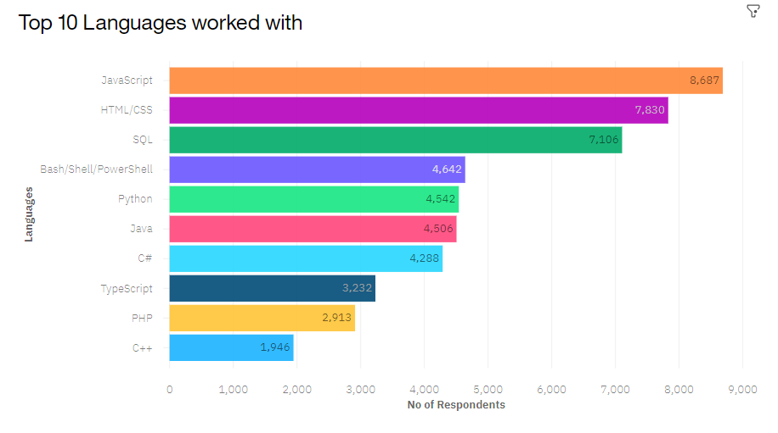
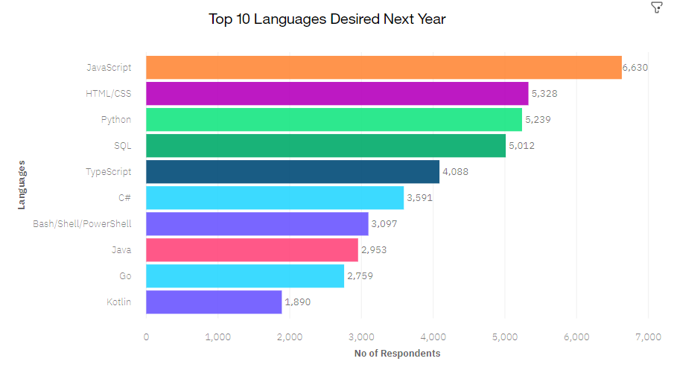
PROGRAMMING LANGUAGE TRENDS
Current Year
Next Year

Slide 9
PROGRAMMING LANGUAGE TRENDS - FINDINGS & IMPLICATIONS
Findings
JavaScript, HTML/CSS and SQL are top 3 for the current year
Since Python has abundant libraries and also with ease of learning it has made its place in top 3 for the next year.
We can see that PowerShell, c++ and php slowly moving out of the top 10 list.
Implications
Importance for JavaScript has not changed.
Since AI and ML require python and hence its increasing popularity,
SQL also still needed by the companies for big data applications

Slide 10
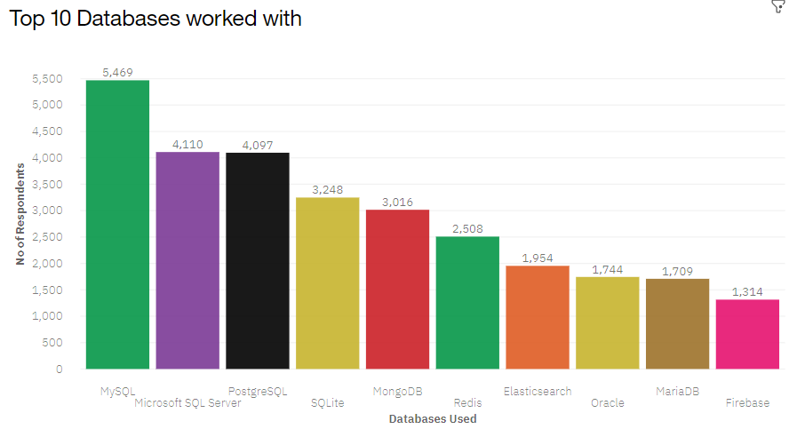
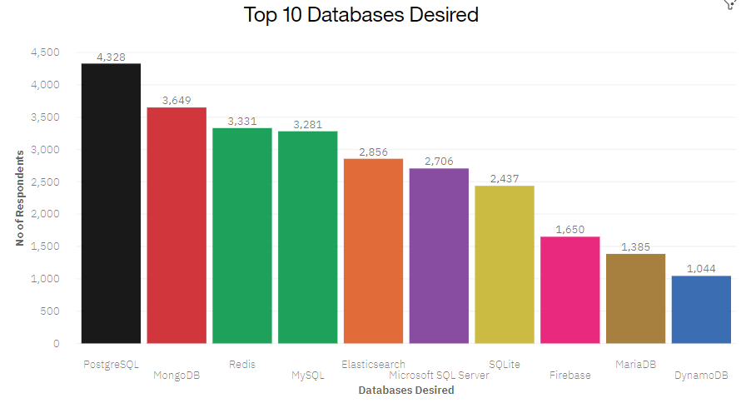
DATABASE TRENDS
Current Year
Next Year

Slide 11
DATABASE TRENDS - FINDINGS & IMPLICATIONS
Findings
MySQL is the most widely used database technology
Microsoft SQL server and Postgre SQL are close second and third
Oracle lost its place in the top for the coming year.
Implications
NoSQL type database like MangoDB is gaining importance in the industry.
Redis Database also gained more importance compared to the previous year since it supports various types of abstract data types.
Open Source databases are still in demand.

Slide 12

DASHBOARD
https://eu-de.dataplatform.cloud.ibm.com/dashboards/7e400a5a-56b0-4a27-83f9-4cccaa92bca4/view/797be37a249662fe44fef2e407ca7a017a34230fb4bb855682d67b4909332097a8684291c8791a59d317076bf1e8460bc0

Slide 13
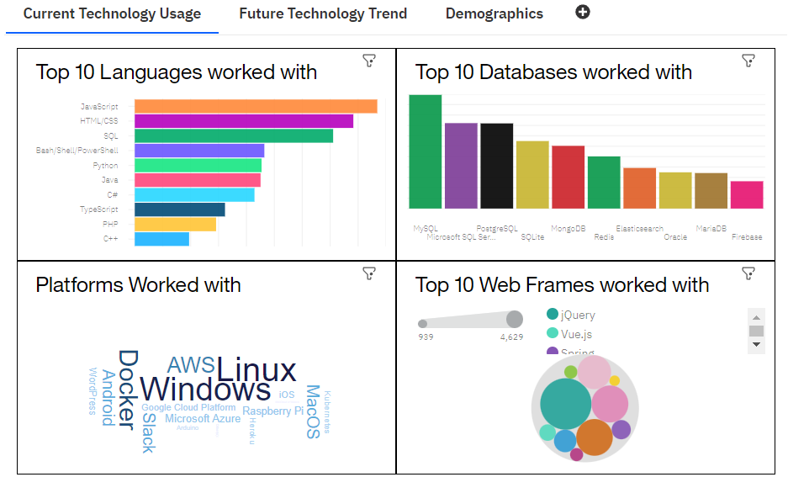
DASHBOARD TAB 1

Slide 14
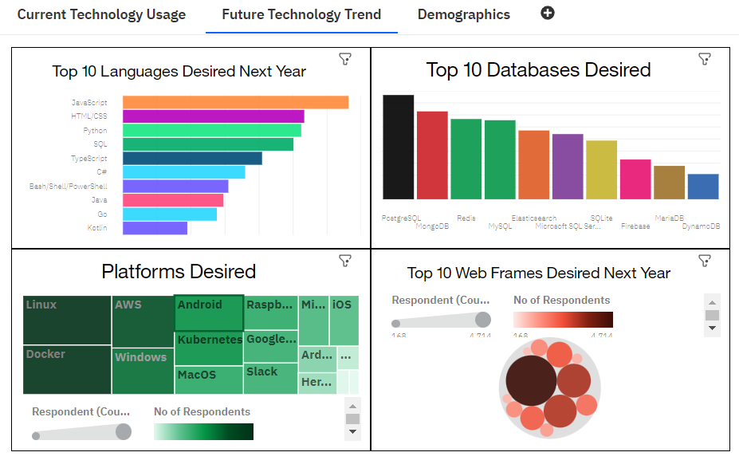
DASHBOARD TAB 2

Slide 15
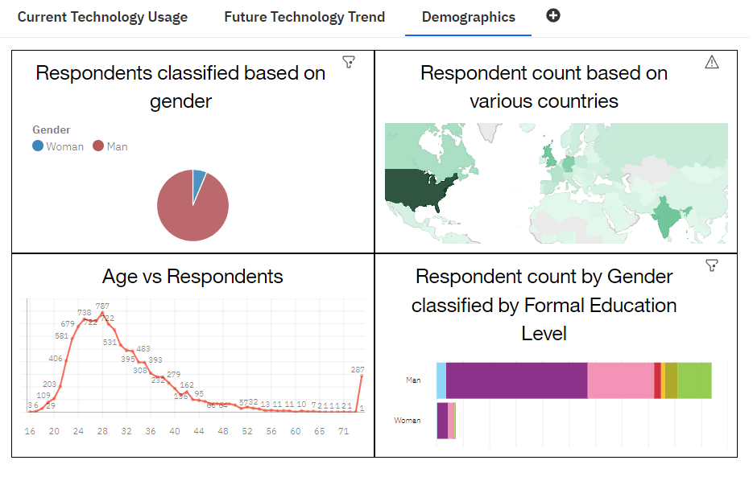
DASHBOARD TAB 3

Slide 16
DISCUSSION
Trends in various technologies keep on changing year after year.
Upskilling according to the fast changing trends is very much needed to match the industry standard.
There is not much respondents belonging to other countries other than US, India, Canada etc.,
Difference between the ratio between Men and Women respondents is huge.

Slide 17
OVERALL FINDINGS & IMPLICATIONS
Findings
Technology trends are changing every year.
Platforms like Docker and AWS are getting popular and being used more.
NoSQL databases are being used more because of the flexibility it offers.
Huge difference between Men and Women respondents percentages.
Also the more number of respondents are belonging to the age group of 25 to 30.
Implications
Upskilling is necessary to be in line with the fast changing technology trends.
Companies should also be in a lookout for these trends and adjust to the changes to get maximum output or productivity.
Women also should participate more in the survey and put forth their opinions.
Concentration of techies are very less in most of the countries as seen in the country based respondent count map visualization.

Slide 18

CONCLUSION
Constant Upskilling is necessary to be in line with fast changing technology trends
Companies also should adapt to these changes in trends which yields them better output.
Technologies should move to lot of other developing countries or the respondents from other countries also should participate in the survey and provide their inputs.
Age group concentration as well gender concentration should improve in the coming years.

Slide 19
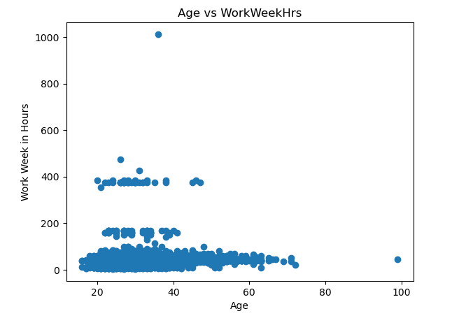
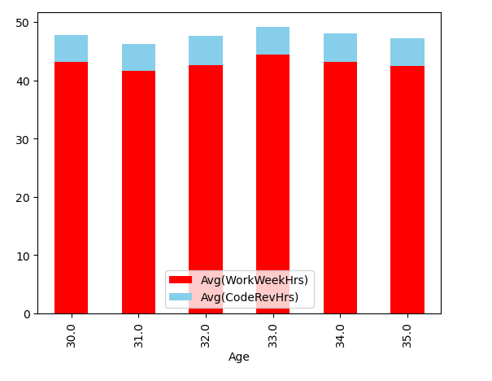

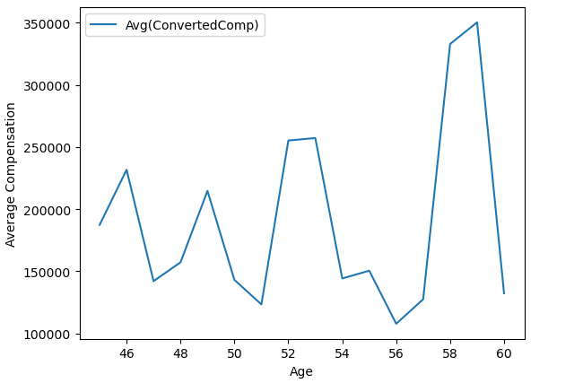
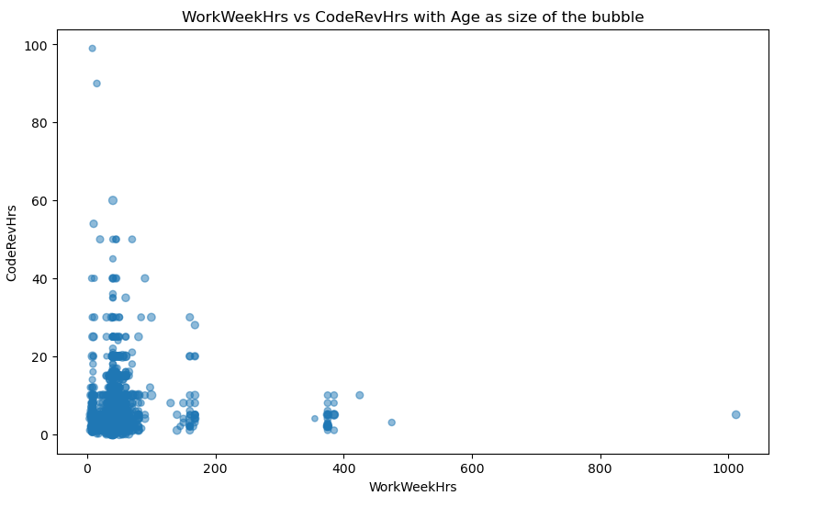
APPENDIX

Slide 20
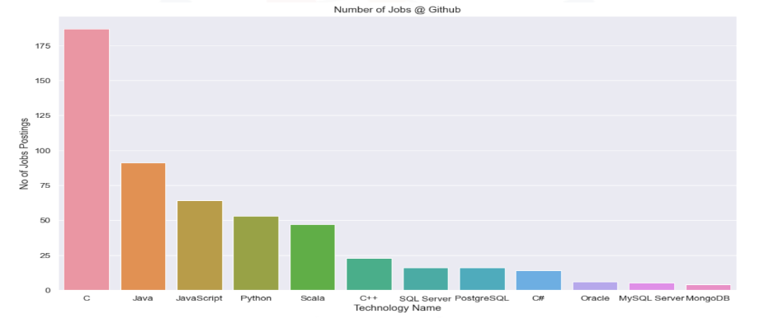
JOB POSTINGS

Slide 21
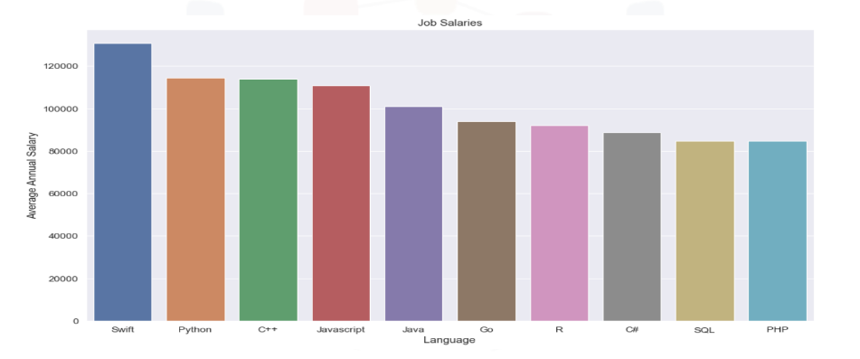
POPULAR LANGUAGES

